Slide 1


Denise McBride
Student Success Coach
(College of Science and Engineering)
Room 236,
Arts/Science Building, Concourse
Reach out by email
denise.mcbride@universityofgalway.ie

Slide 2
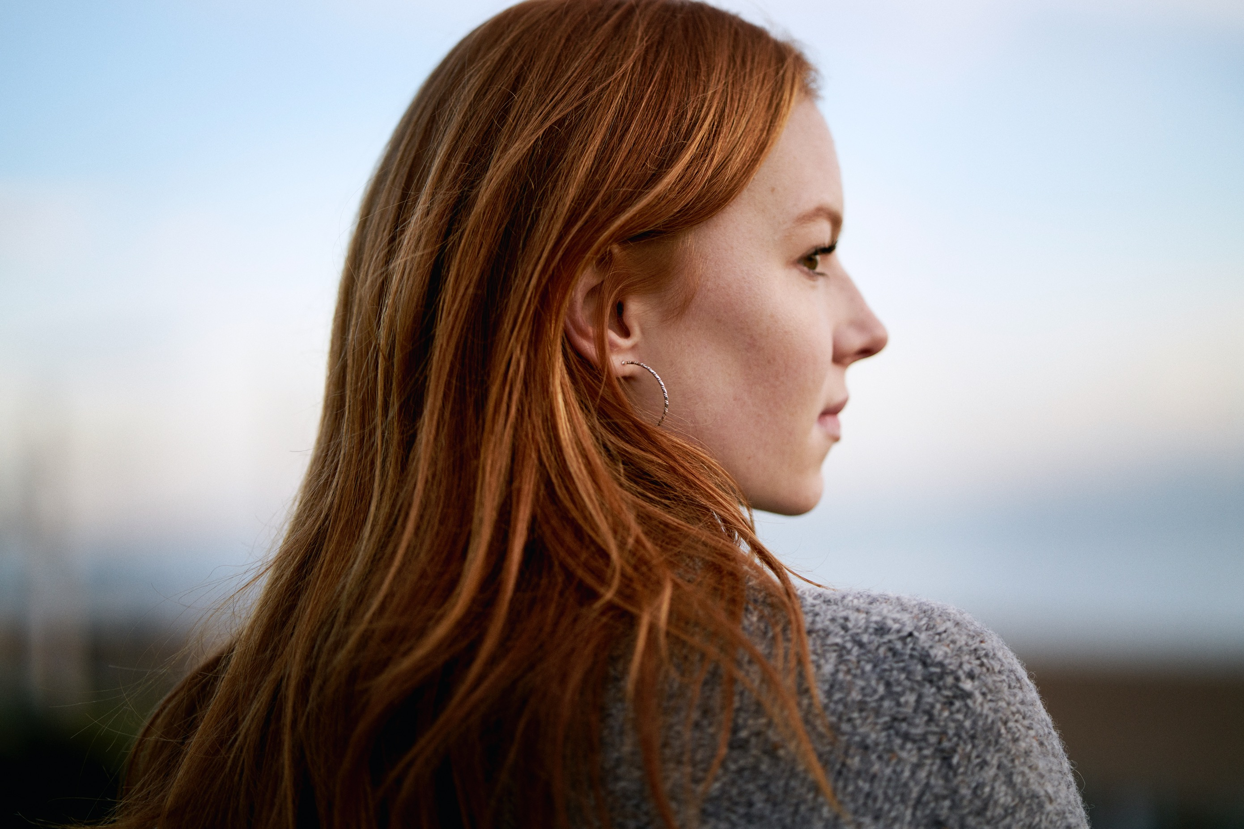
What is Coaching?
It’s a one to one (or group) session with a person who is always interested in your progress.
It can help you decide on actions to move forward, and encourage you to learn more about yourself and how you can succeed in achieving YOUR goals.
Available face to face, online or in small groups

Slide 3
Why work with a Coach?
For personal development!
I can work with you on a One to One basis to; help you stay motivated and get the most out of your university experience, gain self-awareness about your goals, interests, talents and values, make well-informed decisions about your educational and professional goals based on self-reflection and, to become more socially connected with your University community.
Denise McBride
Student Success Coach
(College of Science and Engineering)
Room 236,
Arts/Science Building, Concourse
Reach out by email
denise.mcbride@universityofgalway.ie

Slide 4
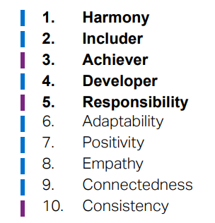
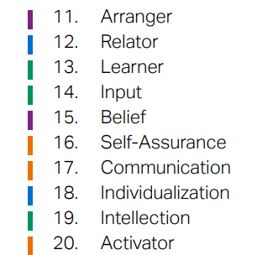
I work with you as a coach by looking at your personal strengths.

Slide 5
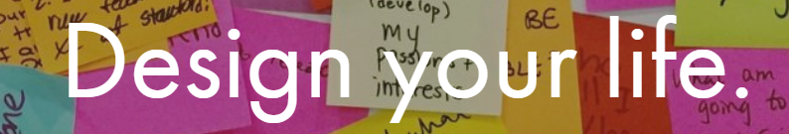
Example Workshop
DESIGN YOUR ENERGY
How can you design more energy into your life?

Slide 6
ENERGY – ENGAGEMENT MAP WORKSHEET
+
STEP 1: List your top energy giving or draining regular activities/engagements:
_________________________________
_________________________________
_________________________________
_________________________________
_________________________________
_________________________________
_________________________________
STEP 2: Draw a bar of each one’s (+) or (-) energy effect, as it shows up in your typical day or week.
ENERGY
TIME
__

Slide 7
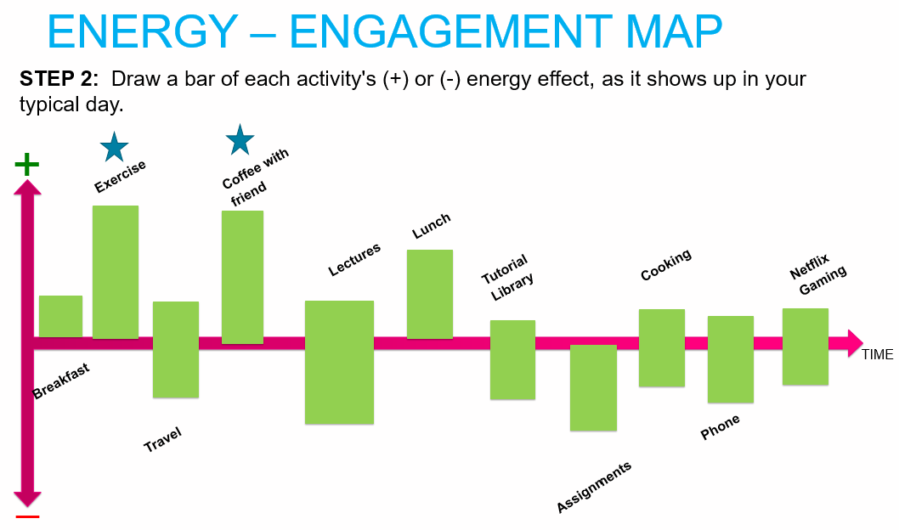

Slide 8
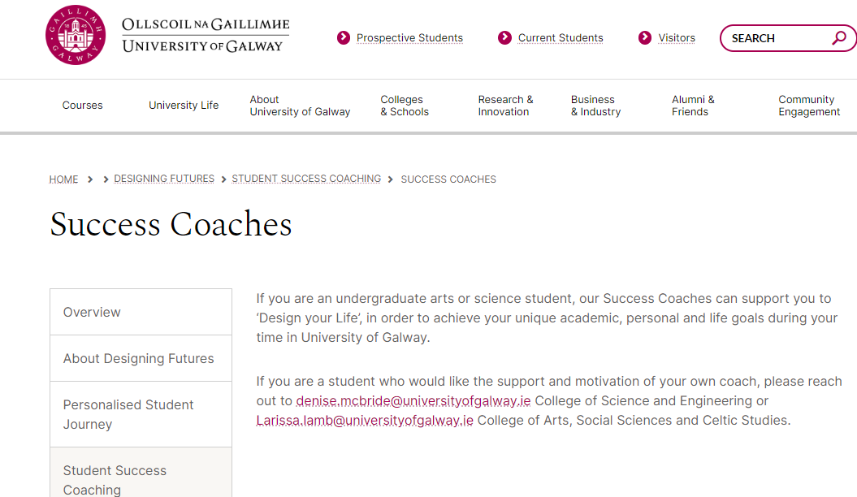
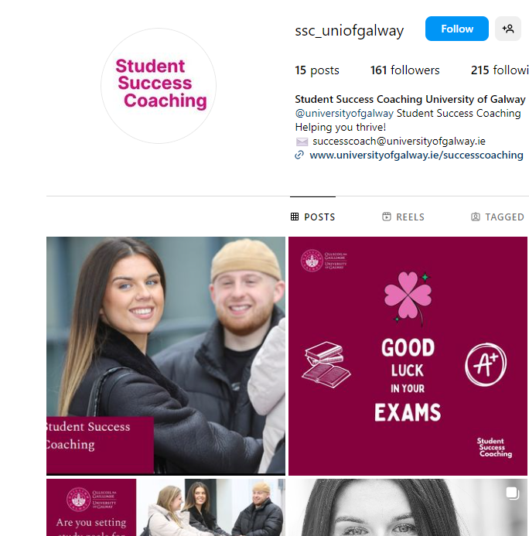
Thanks for listening!
Would you like your own Coach?
Reach out.
Denise McBride
Student Success Coach
(College of Science and Engineering)
Room 236,
Arts/Science Building, Concourse
Reach out by email
denise.mcbride@universityofgalway.ie

